Slide 1
L-Band Satellite Tracking and Characterization System
Critical Design Review
4 / 19 / 2023

Slide 2
Team names, roles and major, stakeholders, SME, mentor
Dr. Steve Ellingson - Subject Matter Expert/Customer - Primary Stakeholder
Dr. Shelley Stover - Mentor
Charles Kente Van Horn Jr. - Project Manager - RF and Microwave Engineering (EE)
Samuel Walker Taliaferro VIII Velasquez - Machine Learning (CPE)
Justin Daigle- Communications (EE)
Ethan Christopher Duval - Networking and Cyber Security (CPE)
Jared Lane Jamison - Controls Robotics and Autonomy (EE)

Slide 3
PDR Actions Table
 | Confirm that the values for the numbers are met by the engineering standards.- Done | Figure out the time data requirements for the Ops Software (GPS MODULE) <- Ethan or Samuel | Talk to Dr. Ellingson about slide 12. <-I Emailed Him, Will Update Wednesday
Talk to Dr. Ellingson about the GUI on slide 13. <-I Emailed Him, Will Update Wednesday | Add A QT Mock | Add power chart to power slides, that says the amount of power used for each mode. <-Done | Resolve the data sampling issue-might need more storage <- Samuel
Work on the storage capacity requirements (8-bit vs 14-bit) <- Samuel | Operations software derived requirements (spectrum, FFT) need to be fixed.<- Samuel | Risks (give top 5) should have likelihood and consequence - Done | Make a power down sequence, so that the system is ready for an emergency stop. <-Jared
Action # | Requirement | Existing documentation | Plan to fix | Fixed
Confirm that the values for the numbers are met by the engineering standards | ME-1 | The existing documentation does not conform to engineering weight standards. | Find the engineering standards on how much weight is safe for an average adult to transport. | Yes
Figure out the time data requirements for the Ops Software (GPS MODULE) |  |  |  | Yes
Talk to Ellingson about slide 12 | N/A |  | Email Ellingson, and possibly talk to him. | Yes

Slide 4
PDR Actions Cot.
Action # | Requirement | Problem | Plan to fix | Fixed
Talk to Dr. Ellingson about the GUI on slide 13 | PER-3 |  | Email Dr. Ellingson, and possibly see him in person. | Yes
Add A QT Mock |  |  | Add a mock QT to the slides | Yes
Add power chart to power slides, that says the amount of power used for each mode. | POW-1 POW-2 | The calculation that exists is not readable, and is a formula. | Eliminate the formula so that he power for each system is in a table, and more easily read. | Yes
Resolve the data sampling issue | I/O-1 I/O-2 | The storage capacity, should not be a range, it should be a consistent number. | Figure out the storage and then implement this information. | Yes

Slide 5
PDR Actions Cot.
Action # | Requirement | Problem | Plan to fix | Fixed
Operations software derived requirements (spectrum, FFT) need to be fixed. | OP Software derived requirement |  | Figure out the correct radio spectrum, and if we are going to implement an FFT and put these requirements in. | Yes
Risks (give top 5) should have likelihood and consequence | N/A | There are no risks involved, and the few we had did not have a consequence or a probability attached. | Figure out what our risks are, how they could affect our project, and how to mitigate them. | Yes
Make a power down sequence, so that the system is ready for an emergency stop. | N/A | The Emergency switch to be added could damage the computer if not properly implemented. | Figure out a way to prepare the computer for a forced shut down so that it is not destroyed. | Yes

Slide 6
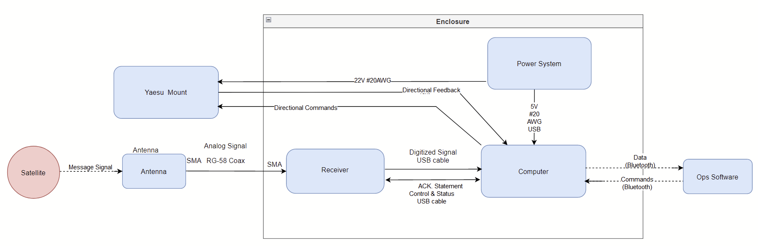
System Architecture Diagram with I/O
*Same As PDR
Blue boxes represent subsystems
Red circles represent external inputs

Slide 7
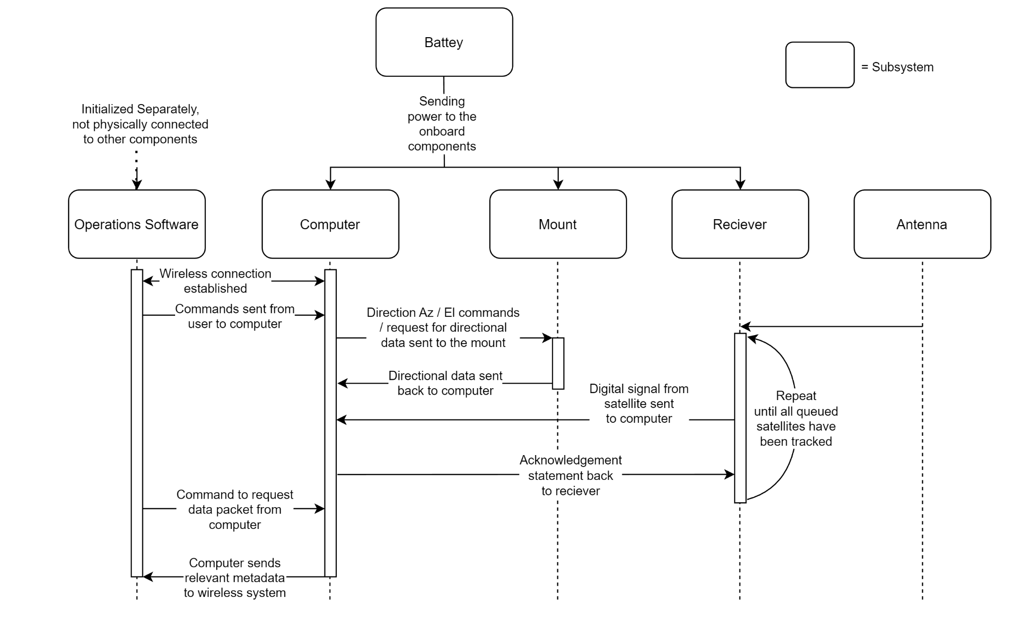
Sequence/Flow Diagram with Interfaces

Slide 8
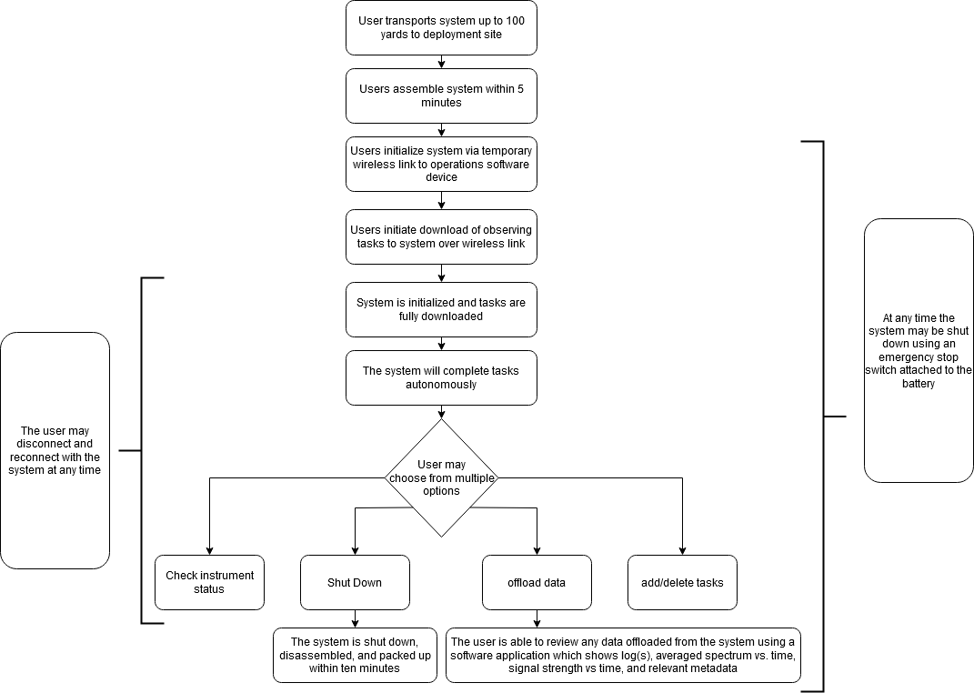
Concept of Operations
*Same As PDR

Slide 9
Computer: Requirements
*Same As PDR
Specific requirements: FUN-8, PER-3, PER-4, ME-1, ME-2, ME-3, I/O-2, I/O-4, COST-1
Based off of these requirements, the computer shall:
Have two USB ports, one for ADC connectivity and one for controlling the mount.
Support the ability to log system performance and diagnostics data.
Have a storage capacity of 128GB to be able to store at least 1 hour of 14-bit data sampled at 10MHz.
In addition, the computer should:
Use Bluetooth for wireless communication.
Have enough memory to record 10 minutes of I/Q sampled at 10MHz.
Have SD card port for non volatile storage.
Have a GPS connection to get its time and position in terms of longitude and latitude.
Cost less than 150$ to account for the rest of the components of the system.

Slide 10
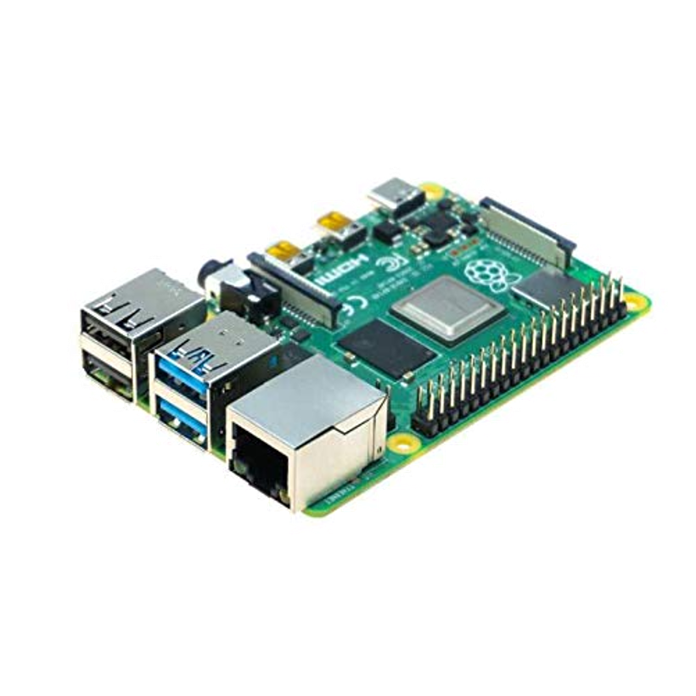
Detailed Design for Computer - Core Components
Computer Platform: Raspberry Pi 4
RAM: 4GB for optimal performance
CPU: 1.5GHz to handle data processing needs
USB Ports: 2 USB 2.0 ports for ADC connectivity and mount control
Storage: 128GB Micro SD card for data storage, additional USB ports for further expansion
Wireless Communication: Built-in Bluetooth 5.0 for seamless connectivity
Memory: Sufficient memory to record 10 minutes of I/Q data sampled at 10MHz

Slide 11
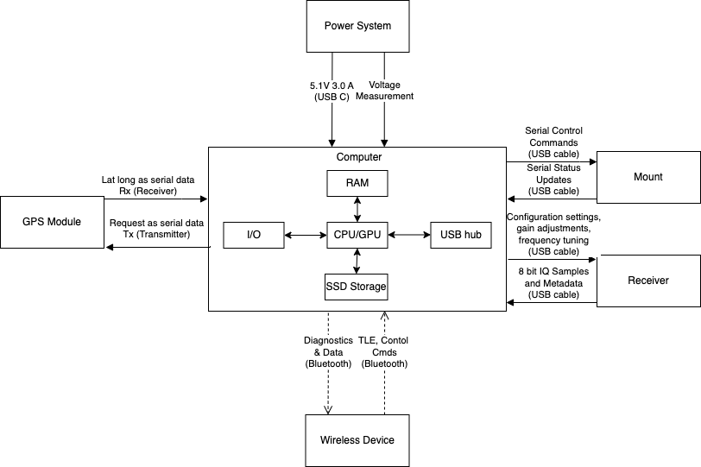
Computer Subsystem Diagram
Total Cost: Raspberry Pi 4 with GPS module estimated at $105
Advantages:
Greater processing power and memory than other alternatives
Built-in connectivity options without the need for additional shields
Support for Python, C, and C++ programming languages
Extensive online resources and ease of use with Python

Slide 12
Operations Software: Requirements
*Same As PDR
Specific requirements: PER-3, I/O-2, I/O-3, I/O-4, COST-1
Based off of these requirements, the software shall:
Display system status and task progress on client side
Allow user to monitor and control the system remotely
Manage data storage, offloading, and task execution autonomously
Be able to plot averaged frequency vs time, and signal strength vs time
Be able to select timed throughout the recording to view the signal at that moment
In addition, the software should:
Provide an intuitive graphical user interface for ease of operation
Communicate with the onboard computer via bluetooth

Slide 13

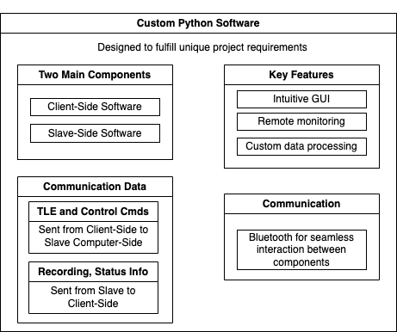
Operations Software Overview
Note: The recordings data will be saved as binary files, which include a tuple containing the IQ samples along with pertinent metadata

Slide 14

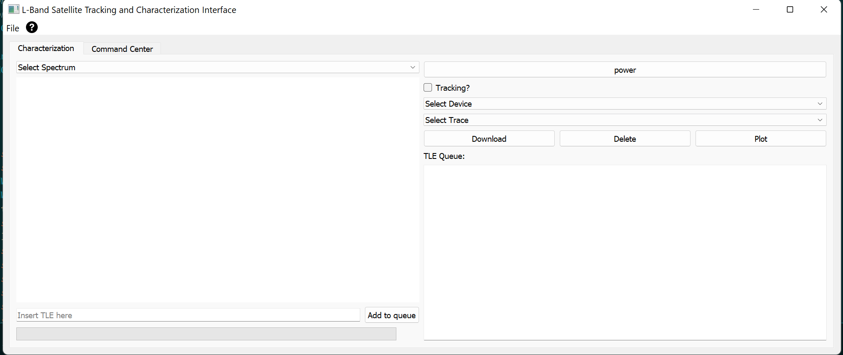
Operations Software GUI Mockup
Note: The GUI is developed using Qt framework for Python

Slide 15
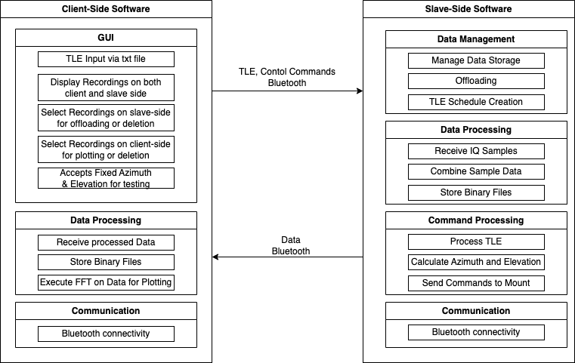
Operations Software Subsystem Diagram
Note: the scheduling algorithm receives the TLE list from the input txt file, computes satellite passes for a specified time period and observer location using the Skyfield library, and generates a tracking schedule for each satellite.

Slide 16
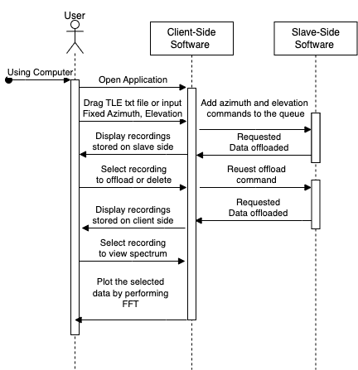
Nominal Operations Diagram
Please note that the client-side software will be executed on a Windows laptop running windows 11, while the slave-side software will run on a Raspberry Pi 4 B.
Notes:
DIscuss input more with ellingson

Slide 17
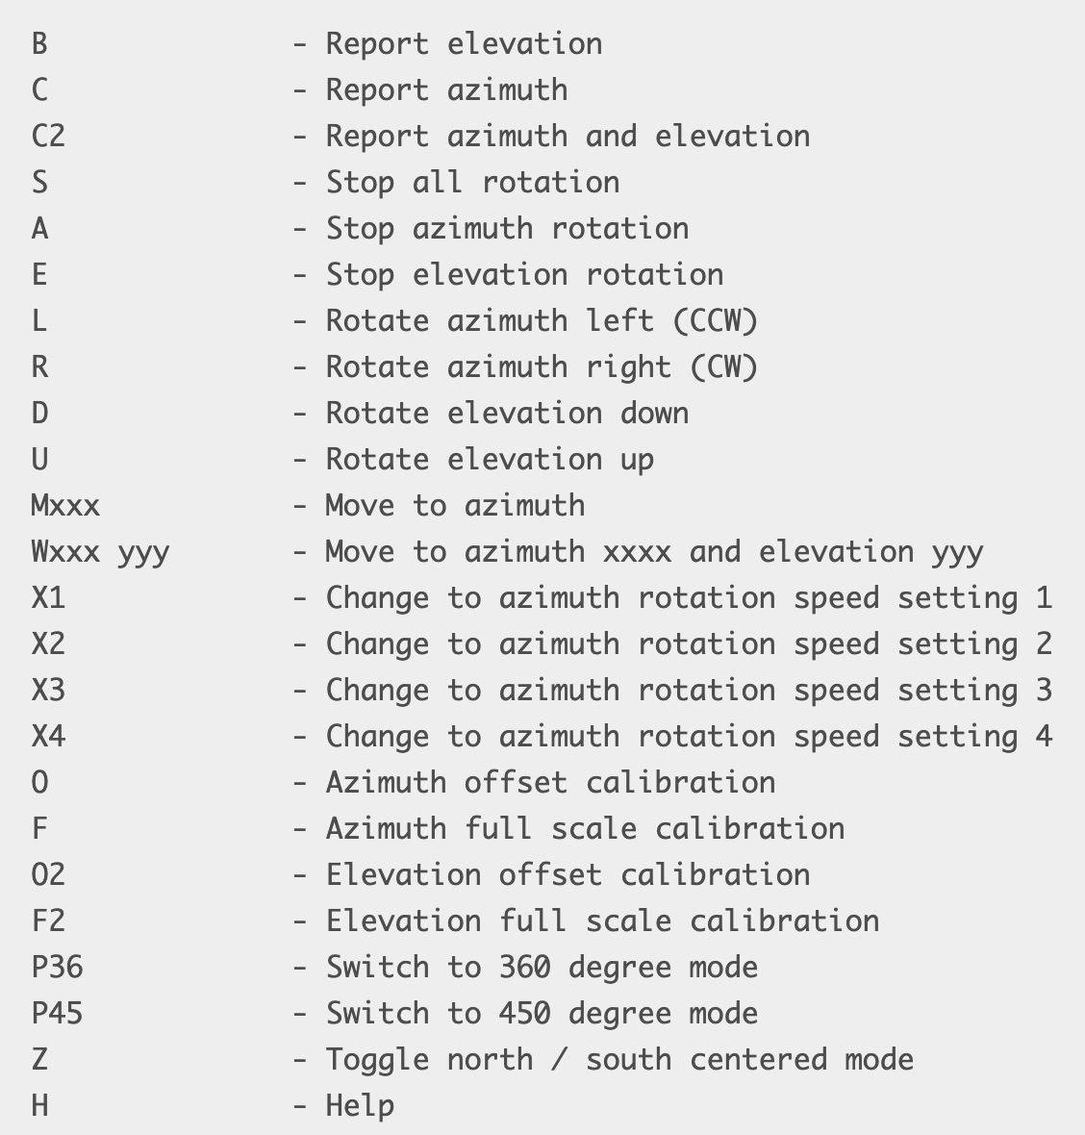
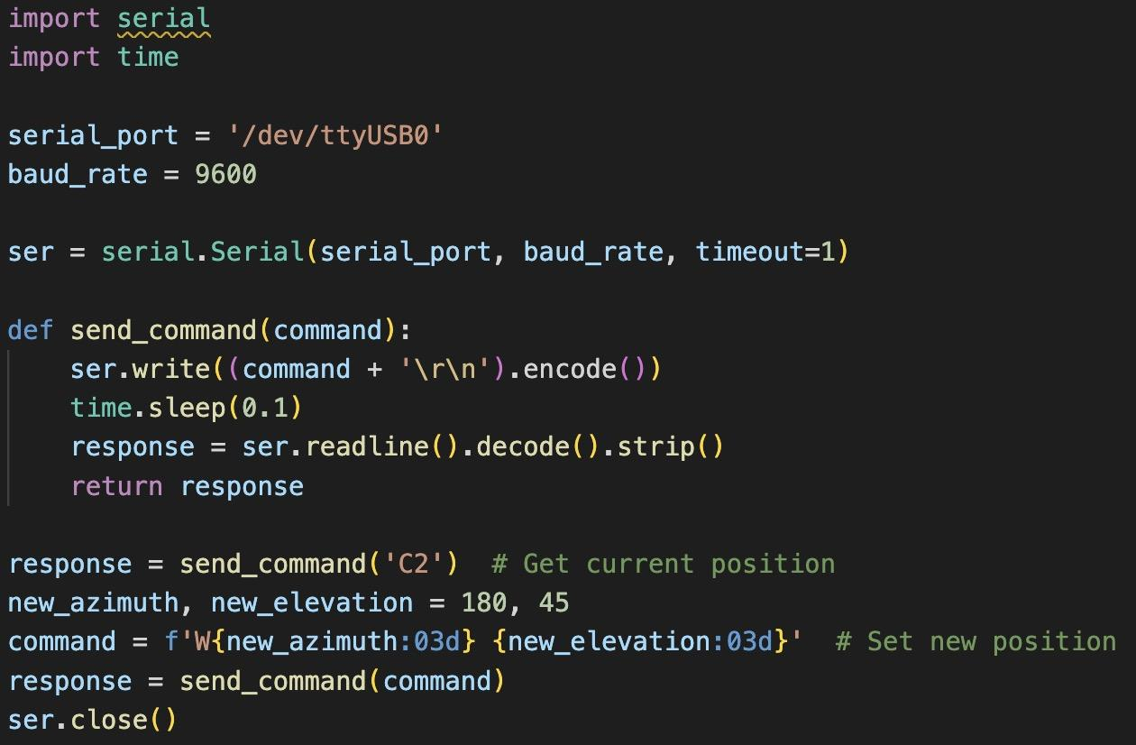
Computer Subsystem Interface with Mount
Establish a serial connection using the pyserial library.
Send commands to control the mount's movement (azimuth and elevation).
Receive status updates on the current position
Example code:

Slide 18
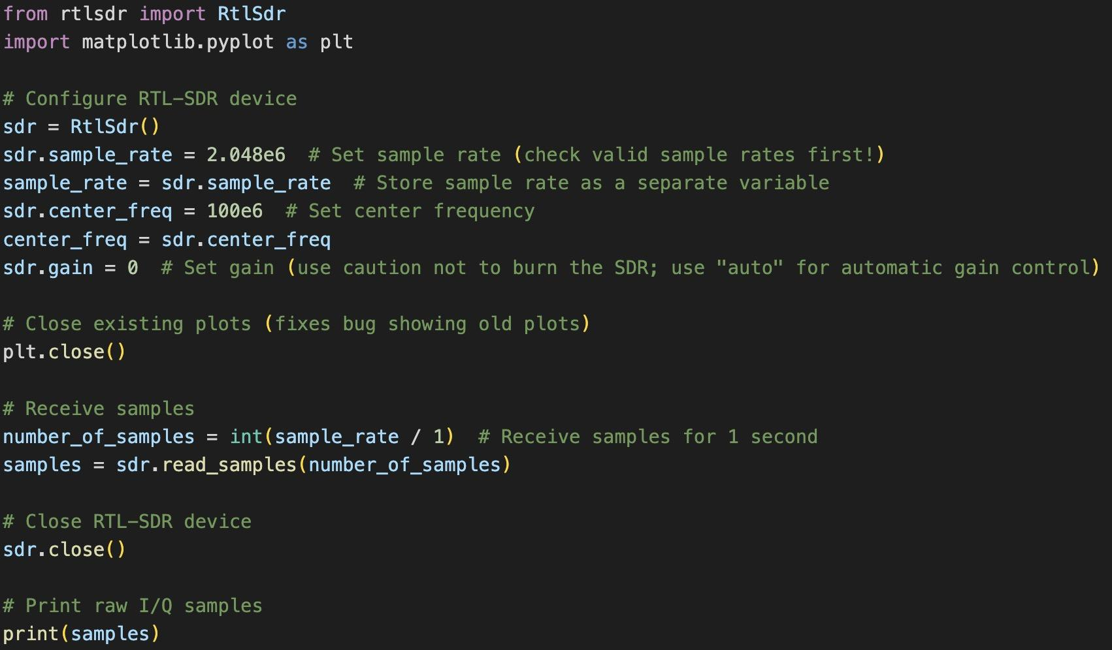
Computer Subsystem Interface with Receiver
Configure RTL-SDR Device
Acquire I/Q Samples
Close SDR Device and Visualize Raw I/Q Samples
Example code:
This slide provides a high-level overview of the Python code used to configure the SDR device, acquire I/Q samples, close the device, and visualize the raw I/Q samples.

Slide 19
Computer Subsystem Bluetooth Communication
Device Discovery:
Search for nearby Bluetooth devices.
Display device addresses and names.
Establish Connection:
Connect to a selected device (Raspberry Pi) using its Bluetooth address.
Send Commands:
Commands are sent after user inputs data in GUI.
Commands are sent to the Raspberry Pi via Bluetooth.
Raspberry Pi Command Processing:
Receive commands from the client.
Execute the commands, including file transfer and system shutdown.

Slide 20
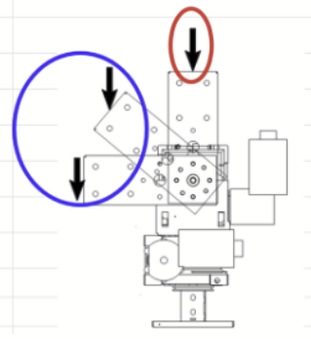
Mount System: Requirements
Specific Requirements: FUN-1, ME-1, ME-2, ME-4, ENV-1, I/O-4, COST-1
From these, the rotator must:
Meet the rotational torque requirement to support our antenna at an Azimuth angle of 0° - 360° and Elevation angle of 0° - 180°.
Have the rotational speed and continuous operational time necessary to track satellites during their orbit.
In addition, the rotator should:
Be USB capable, and able to communicate with the onboard computer over a USB connection.
Remain under a total weight of 30 Kg and cost less than $1100 for the rotator and all required additional systems.
(Average carrying capacity = ~25 Kg of average male, 16 Kg for average female by HSE Standards)

Slide 21
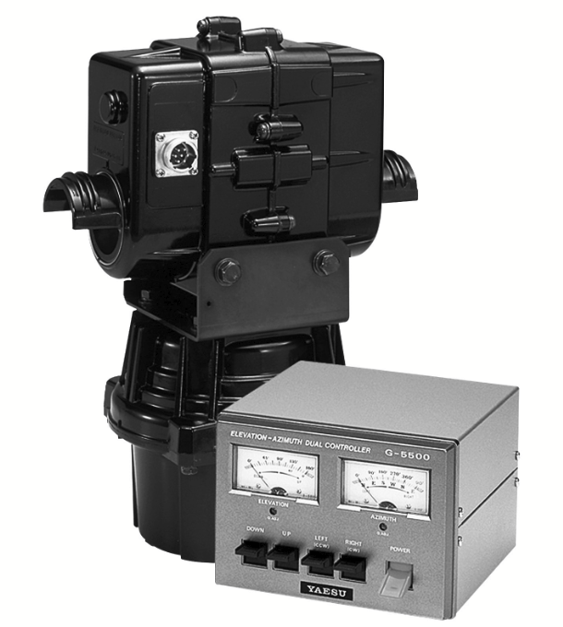
Rotator: The Yaesu G-5500DC Setup Kit
Primarily Devices: Azimuth and Elevation rotators, Yaesu dual controllers, rotator connector clamp.
Additional Components: 8-pin for power of controller, two 7-pin plugs for power and control from dual controller.
Pros and Cons of device:
Pros
Calibration tests + preparation guide provided.
Wiring components tested + provided in kit
Troubleshooting guide on datasheet, and forum for common questions about rotator operation.
Cons
Does not directly link with USB, and needs addons to achieve this functionality.
Needs additional components to be portably mounted.
Needs wires to solder connection pins.
Cost of Yaesu G-5500DC rotator kit = $759.99

Slide 22
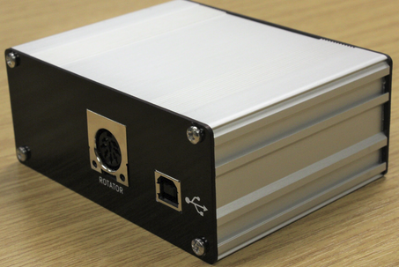
USB Compatibility Addon: JZG GS-232B
The GS-232B interface enables USB control of Yaesu antenna rotators.
Compatible with most radio software packages (PyHamTools = previously tested program), Command Reference Page provided.
Made in the UK, required shipping to the United States.
Total price of system = £95.00 or $116.85.
Addition rotator wires:
10ft Dx Heavy Duty Control Cable: $25.90

Slide 23
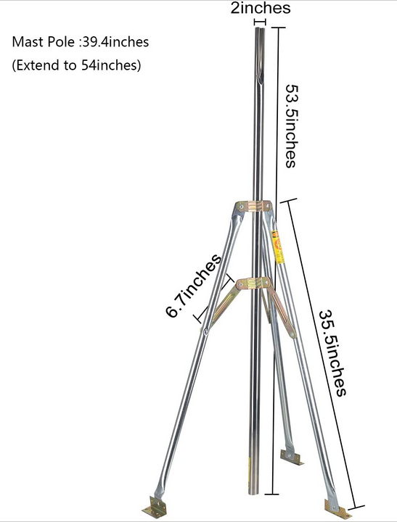
Mount Base: The WEVZENEY Antenna Tripod
Platform design: Built in antenna tripod mount designed for outdoor heavy duty assignments.
Design specifications:
Load Bearing capacity = 30 kg
Tripod kit comes with all required components for setup.
Poles are galvanized to reduce environmental effects.
Tripod feet pre-installed with stake holes, to allow for mount to be securely fastened into ground.
Total cost: $93.49 ($59.99 sale currently out of stock, will return soon).

Slide 24
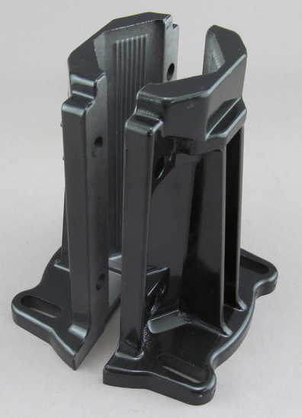
Mount Base Addon: Yaesu GC-038 Mast Clamp
Rotator mount designed to allow Yaesu rotators to be mounted onto masts
Specifications:
Included components: all necessary washers and screws for installation, installation guide with rotator included.
Designed for Yaesu G-1000DXA rotators, and installation included on the rotator testing page.
Made with aluminum casting, securely fasten before use (operable up to 15kg load capacity).
Maximum 2.5 inch masting mount diameter.
Total cost: $49.99 USD for kit.

Slide 25
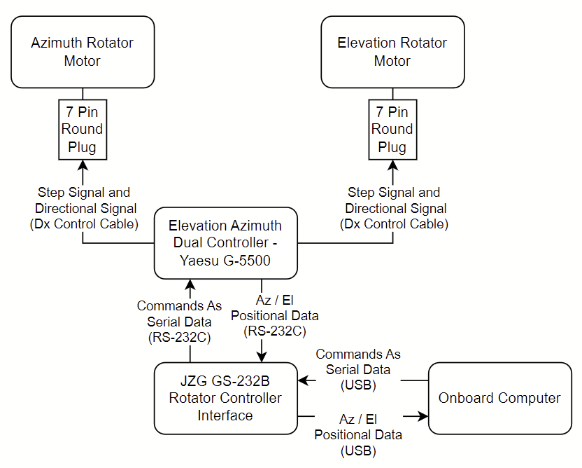
Mount Subsystem Diagram
Yaesu G-5500DC
Raspberry Pi
Notes:
Talk to ellingson about this

Slide 26
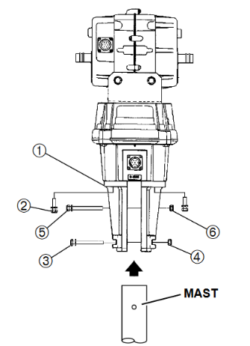
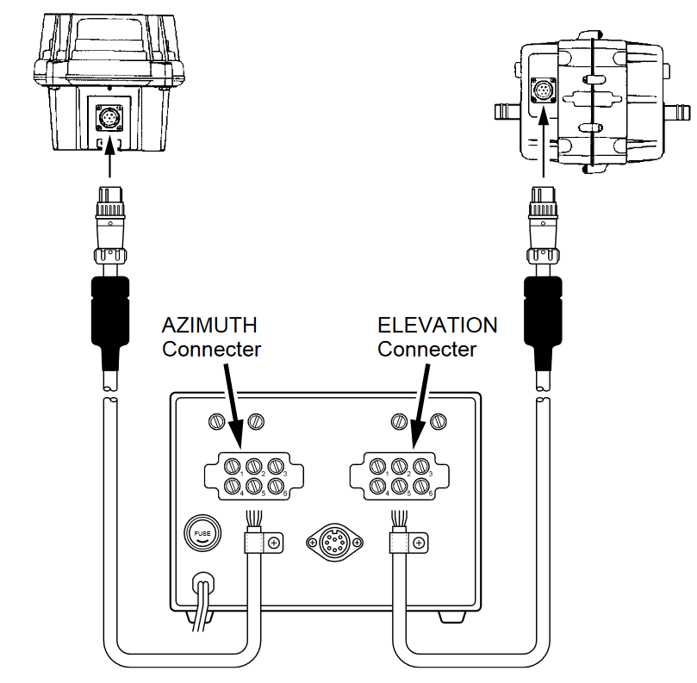
Mount Schematic: Setup and Total Cost
Computer to Rotator
Mast to Tripod
Mount: Total Cost
5500DC rotator cost: $759.99
JZG interface cost: $116.85
GC-038 clamp cost: $49.99
WEVZENEY tripod cost: $93.49
Dx Control Cable: $25.90
Total Cost: $1046.22 for all components

Slide 27
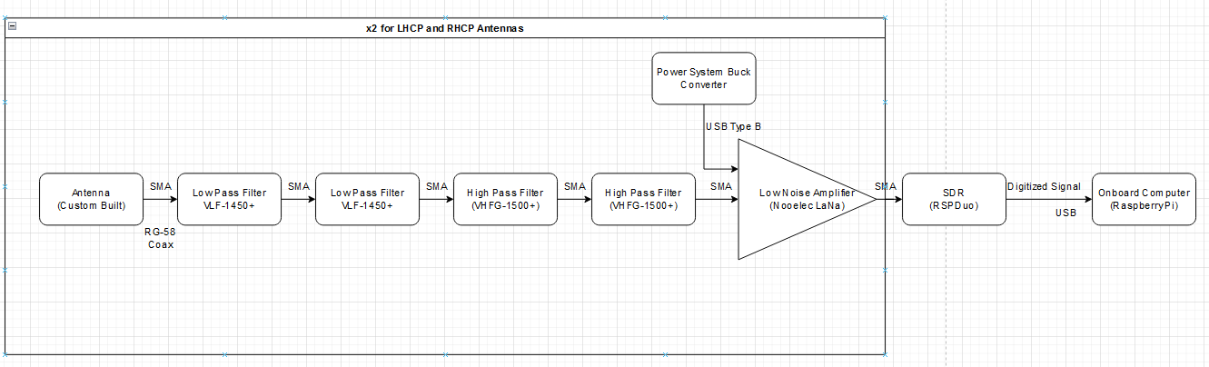
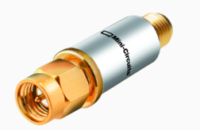
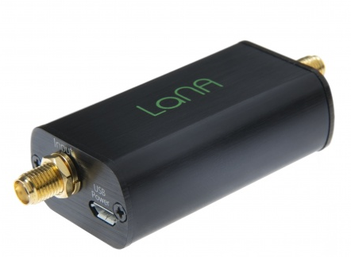
Receiver Subsystem Diagram:
VLF-1450+ & VHFG-1500+
Nooelec LaNa

Slide 28
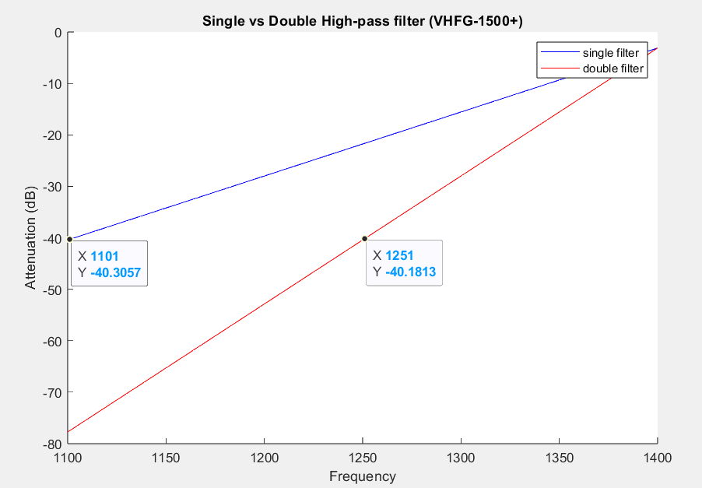
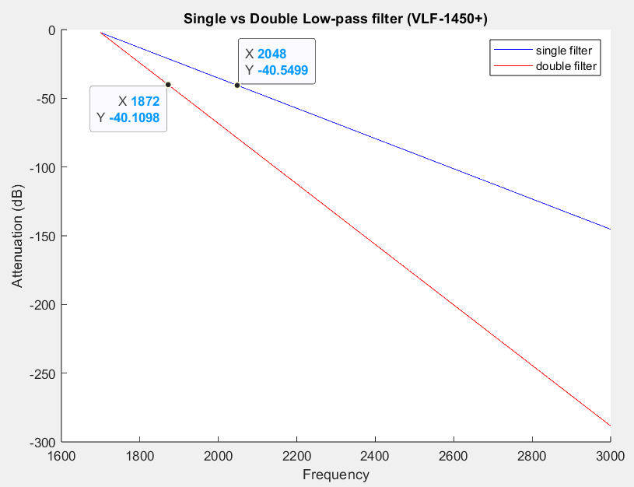
Receiver Preselection Filter Attenuation:
Requirement:
FUN-5 - The system shall have >40 dB rejection of 0.5-1350 MHz and 1800-2700 MHz signals
Increased attenuation estimated by obtaining slope of stop-band drop off and multiplying by two

Slide 29
Receiver Noise Temperature:
Requirement:
FUN-2: The system shall have a receiver noise temperature less than 200K
Frequency (MHz) | RspDuo Noise Figure (dB) | External LNA Noise Figure (dB) | External LNA Gain (dB) | Cable Loss ~10ft (dB) | Reference Noise Temperature (K) | Antenna Noise Temperature (Estimate) (K) | System Noise Temperature (K)
1400 | 4.66 | 1.2 | 26 | 2.06 | 300 | 35 | 129.989
1500 | 4.95 | 1.24 | 26 | 2.159 | 300 | 35 | 133.847
1600 | 5.27 | 1.3 | 26 | 2.256 | 300 | 35 | 139.592
1700 | 7.47 | 1.4 | 26 | 2.352 | 300 | 35 | 151.575
Average | 5.5875 | 1.285 | 26 | 2.20675 | 300 | 35 | 138.75075

Slide 30
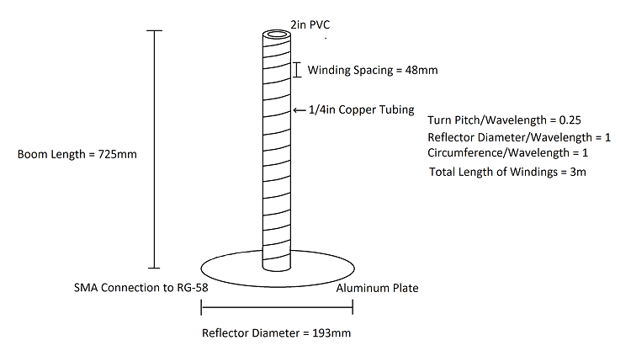
Antenna Schematic:
(Windings Mirrored for LHCP Antenna)
Gain = 25.8dBic
Half-Power Beamwidth: 26.8 degrees
Calculations determined using ARRL Antenna Book for Radio Communications

Slide 31
Power System Derived Requirements
*Same As PDR
The power system shall power the mount for at least 1 hour of operation, and the computer system for 18 hours.
The Power system shall have a supply voltage of 12 volts
The battery should be a lithium ion or deep cycle battery to ensure a steady discharge rate.
The battery should also not lose charge if fully discharged.
The battery shall have an emergency stop switch tied to the power lead.
The battery should have to power the computer at max power for two hours at a minimum, and the mount for an hour and a half.

Slide 32
Additional considerations
An emergency stop will be connected to the positive terminal of the battery so that the power can be cut in an emergency.
A simple voltmeter will be connected to the battery. This is to provide the user with some sense of how much longer the battery will last. This will be connected after the emergency stop so that all electricity flow stops once the emergency stop is pressed.
Once fully discharged, the battery will take around 8 hours to charge.
Two fuses will be added for safety reasons. These will added after the computer and mount to prevent current overdraw.

Slide 33
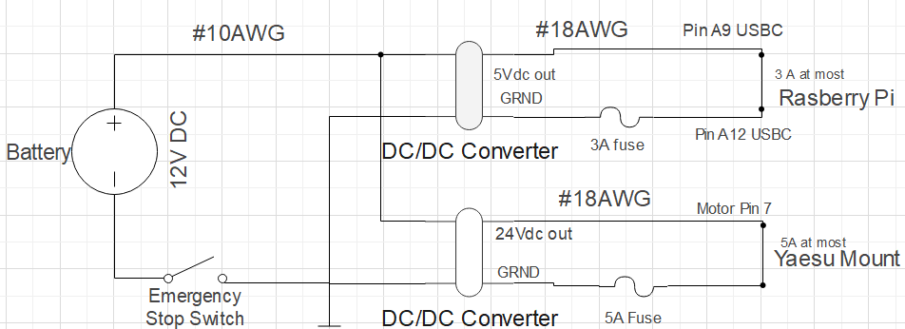
Power Circuit Diagram

Slide 34
Power calculation
The battery must power the computer at max power for 2 hours, and at idle for the other 16. The battery must also power the mount for at least an hour and a half.
Based on this analysis, which assumes that all of the on time for the power circuit will be in a continuous line, a larger battery will be needed to avoid power drop off when not powering the circuit for possibly hours.
System | Voltage required | Amperage total | Time (hours) | Watt Hours | Compensated for inverter | Amp Hours
Computer | 5V | 3A | 2 | 30Wh | 30/0.8 | 3.125Ah
Computer(low power) | 5V | 0.514A | 16 | 41.12Wh | 41.12/0.8 | 4.28Ah
Mount | 24V | 4.5 | 1.5 | 162Wh | 162/0.8 | 16.875Ah
Total | N/A | N/A | N/A | 233.12Wh | 233.12/0.8 | 24.28Ah

Slide 35
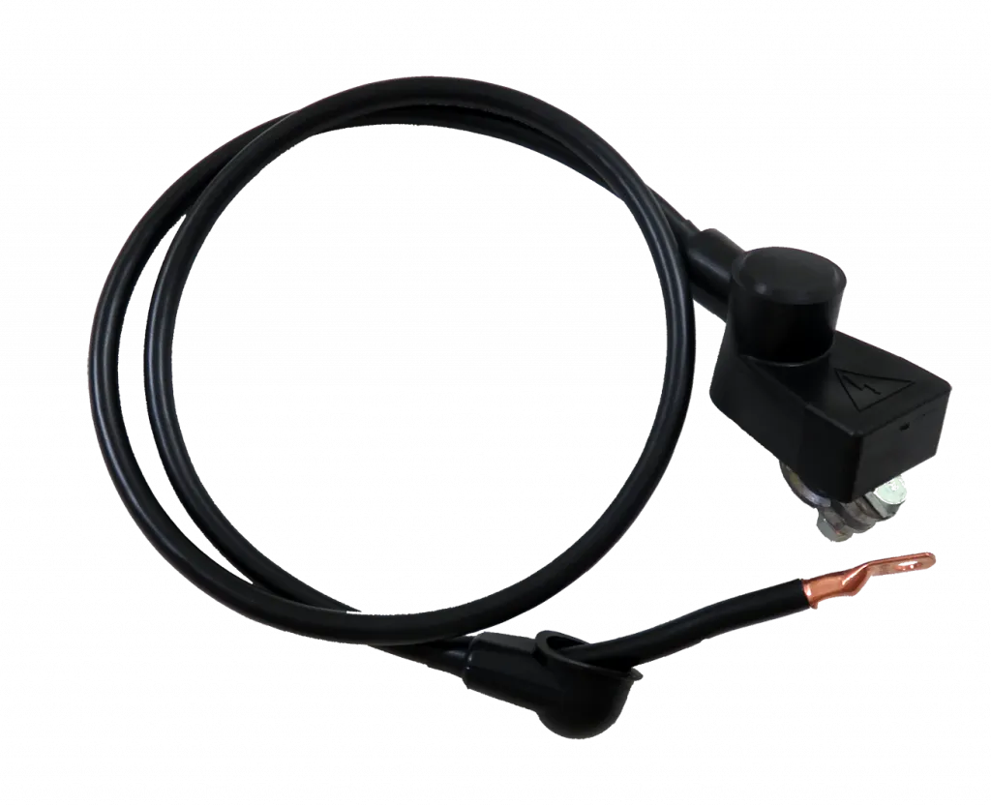
Grounding
The common ground of the system will be a wired ground.
Since the enclosure will be electrically isolated, and the tripod mount will be physically connected to the earth, a chassis ground will not work.
This means every connection will require a wired path back to the negative battery terminal.
This will be accomplished using the same #10 AWG wire connected to the positive terminal.

Slide 36
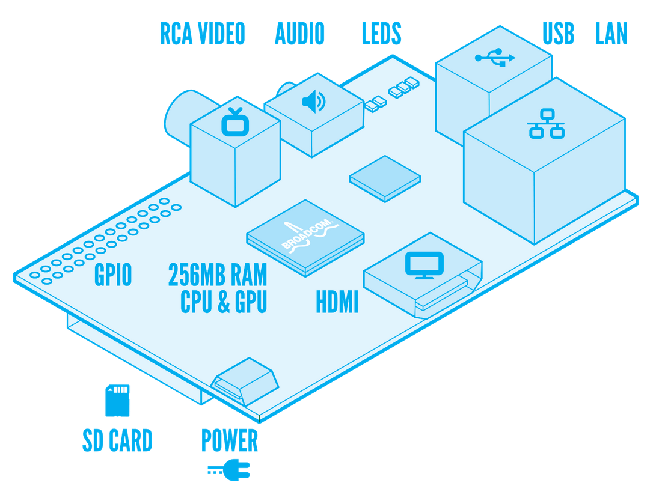
Enclosure Requirements
Must be waterproof.
Must be large enough to enclose the Raspberry Pi, Receiver, and the two DC/DC converters.
Must allow for signals to pass through without distortion.

Slide 37
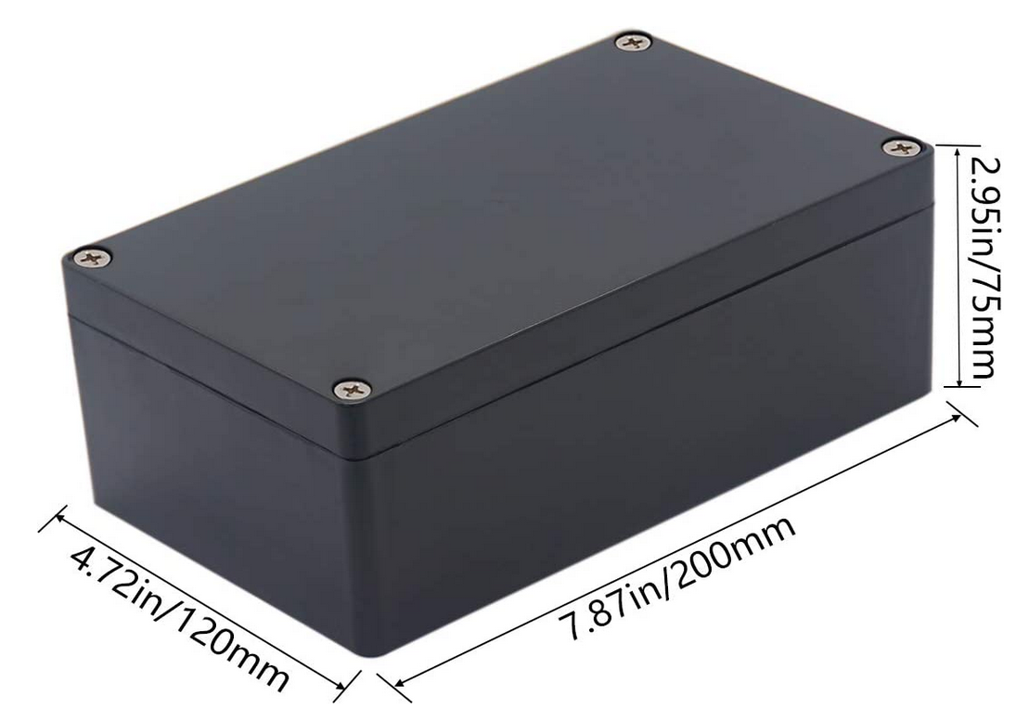
Enclosure Cont.
We decided to use the Raculety Project Box IP65 as our project’s enclosure.
Pros:
Cheap ($8.99)
Easily obtainable
Waterproof
Relatively durable.
To facilitate wires passing through, we can drill holes through which to pass the wires, and then seal the hole with silicone (recommended on website).

Slide 38
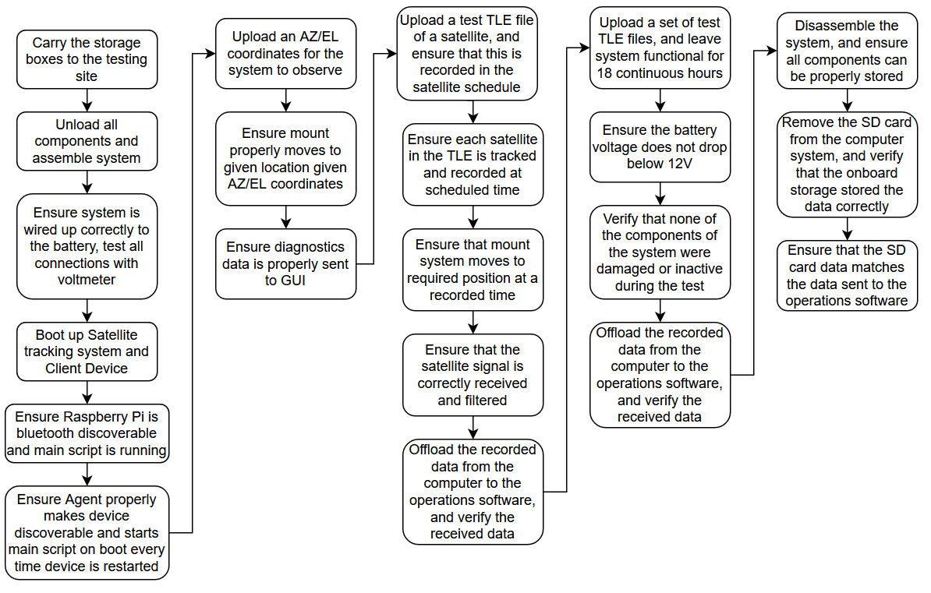
Testing Procedure Overview

Slide 39
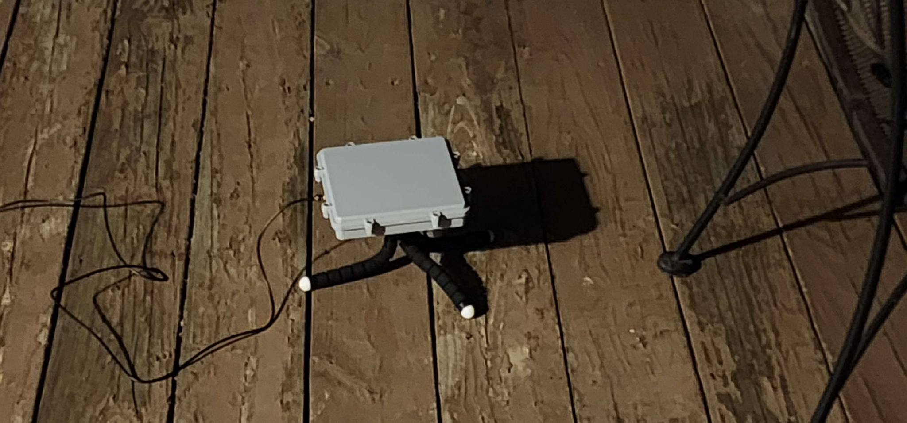
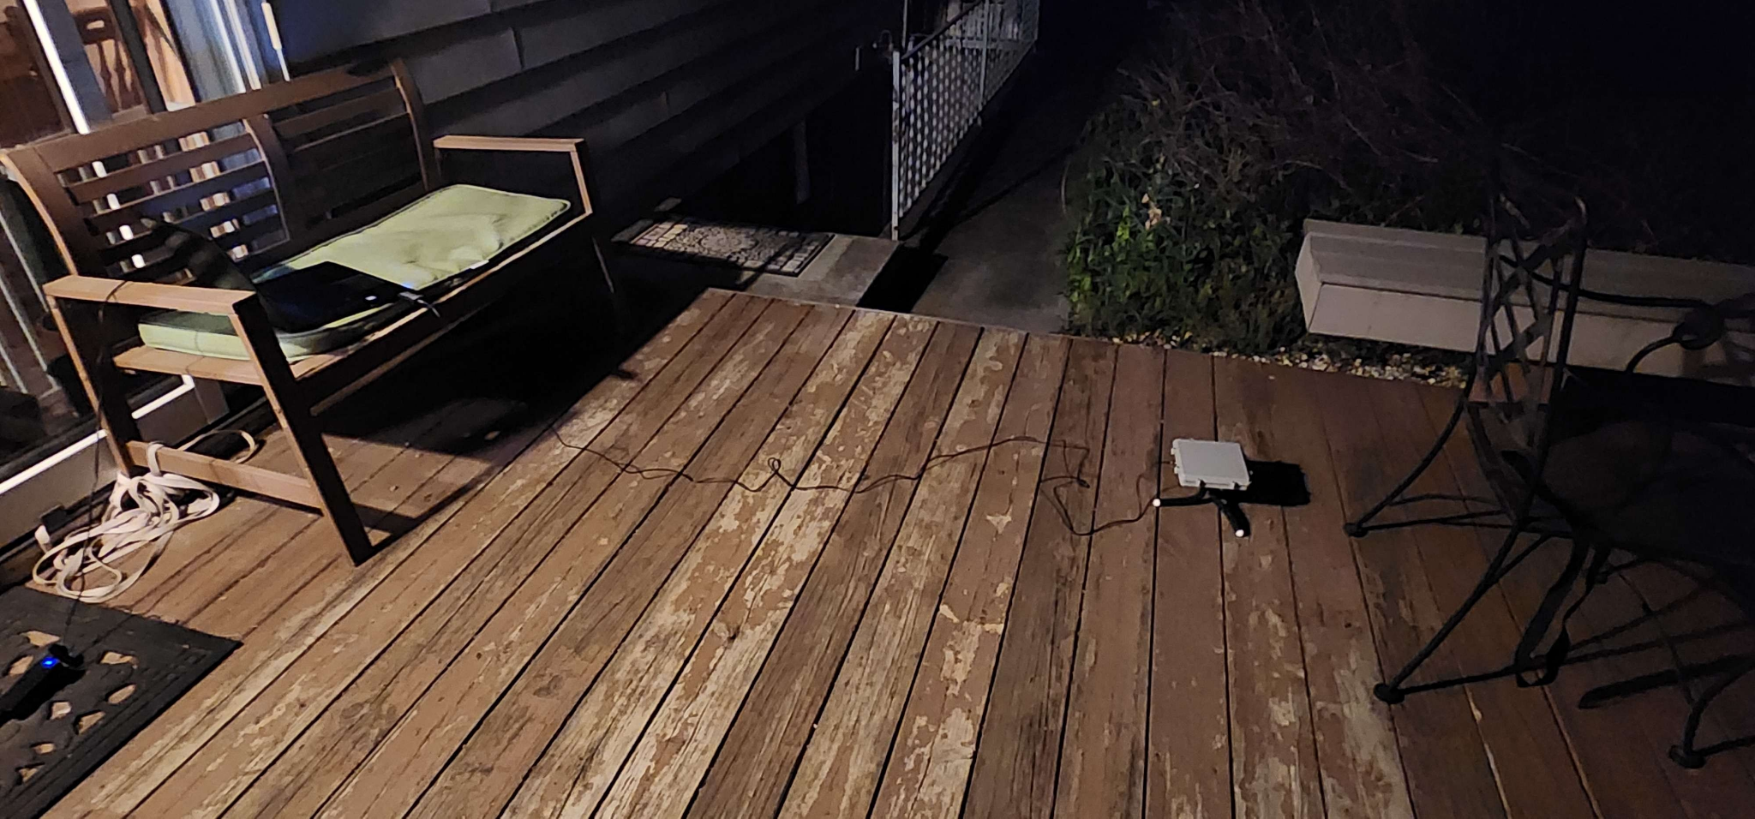
Proof of Concept:
Iridium Satellite Signal Capture:
Setup:
RTL-SDR V3 Fed by 1500-1700MHz patch antenna with internal LNA

Slide 40
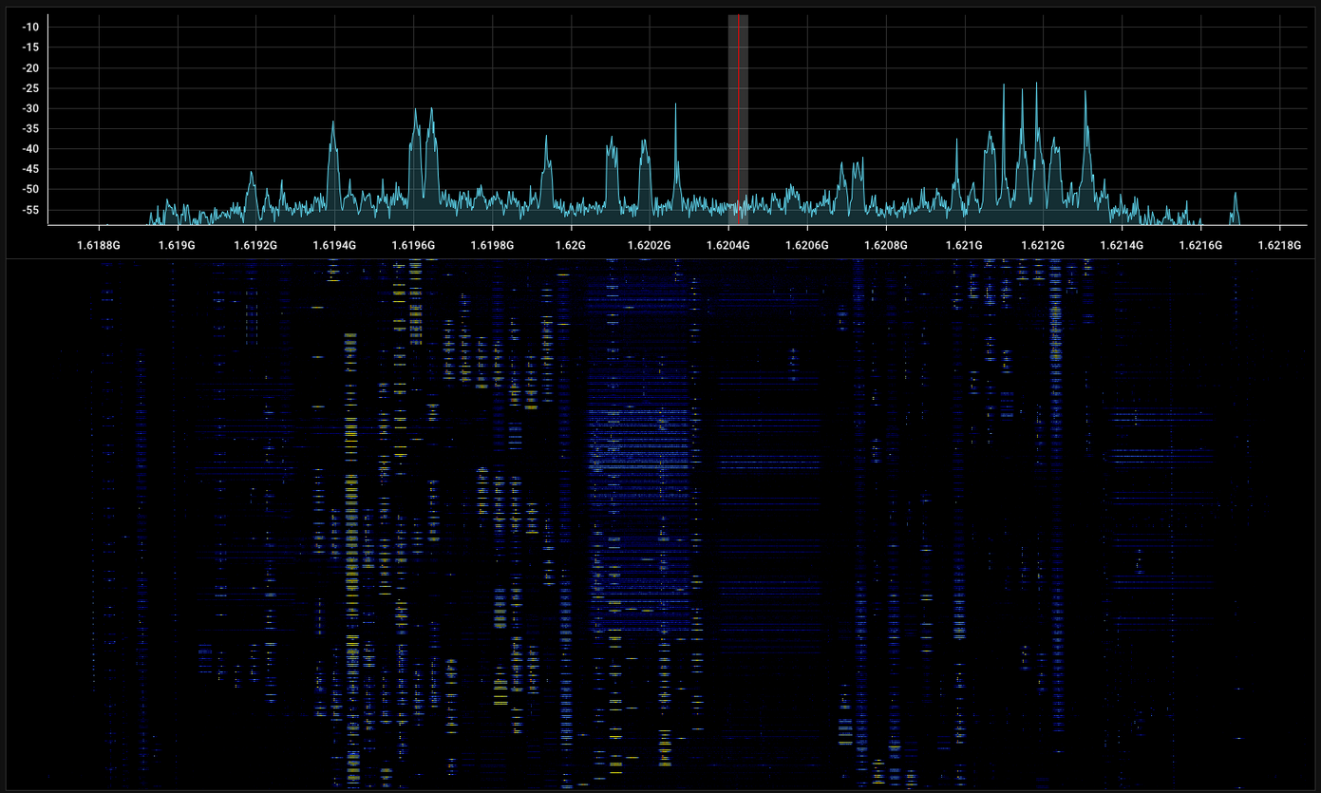
Signal Capture:

Slide 41
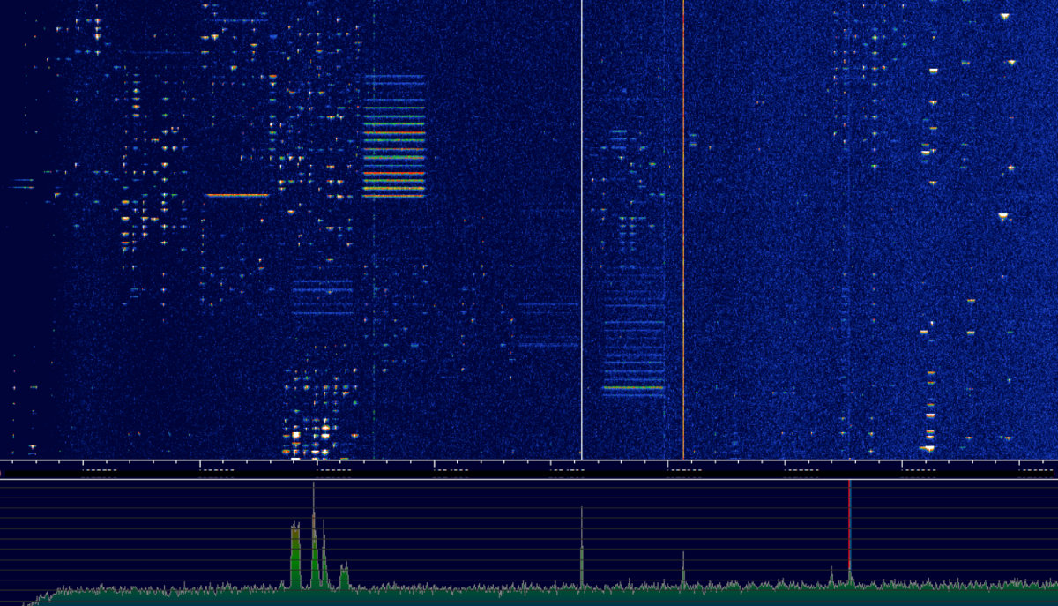
Visual Match to known Iridium Captures:
(Xakep.ru Iridium-Inmarsat Decode)

Slide 42
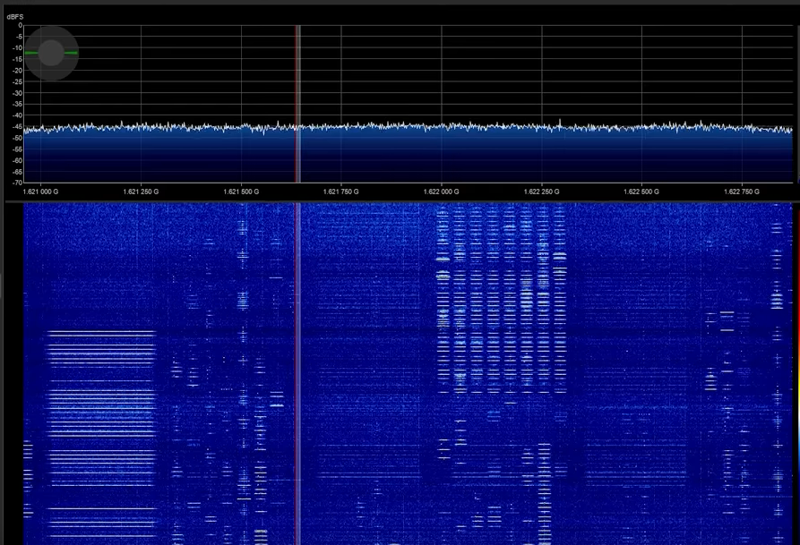
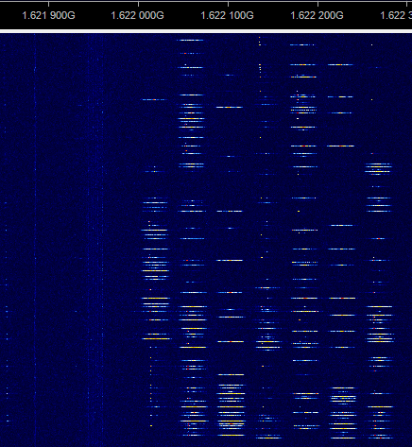
More known captures:
(RTL-SDR BLOG L-BAND Patch Antenna Version 2 - Inmarsat - Iridium - GPS - Tech Minds Youtube)
Our signal capture visually matches the bursts seen at the same frequencies as other people have recorded with SDRs.
(signal identification wiki)

Slide 43
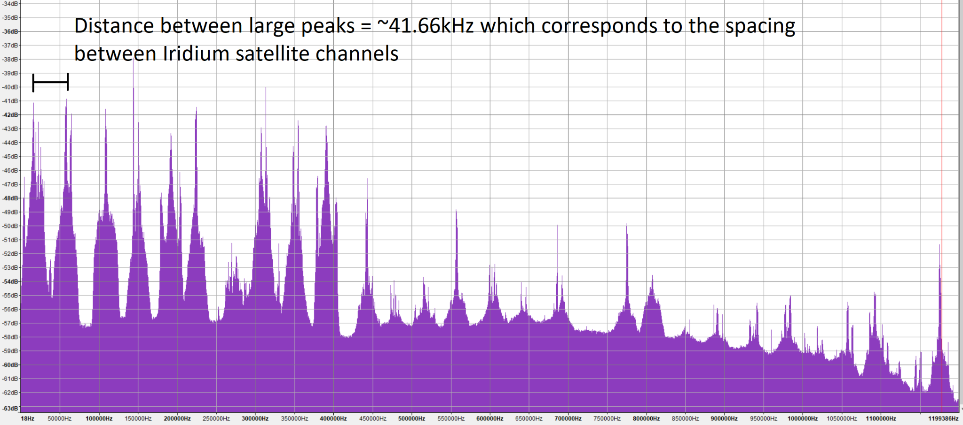
Spectrum Analysis:
Spectrum analysis performed using Audacity

Slide 44

Proof of Concept System in Operation

Slide 45
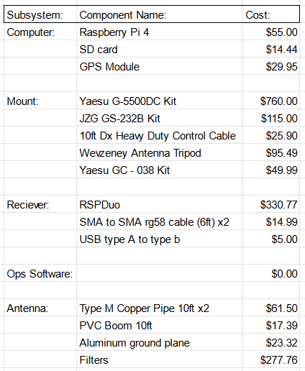
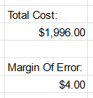
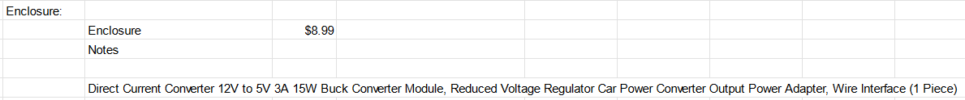
Costs

Slide 46
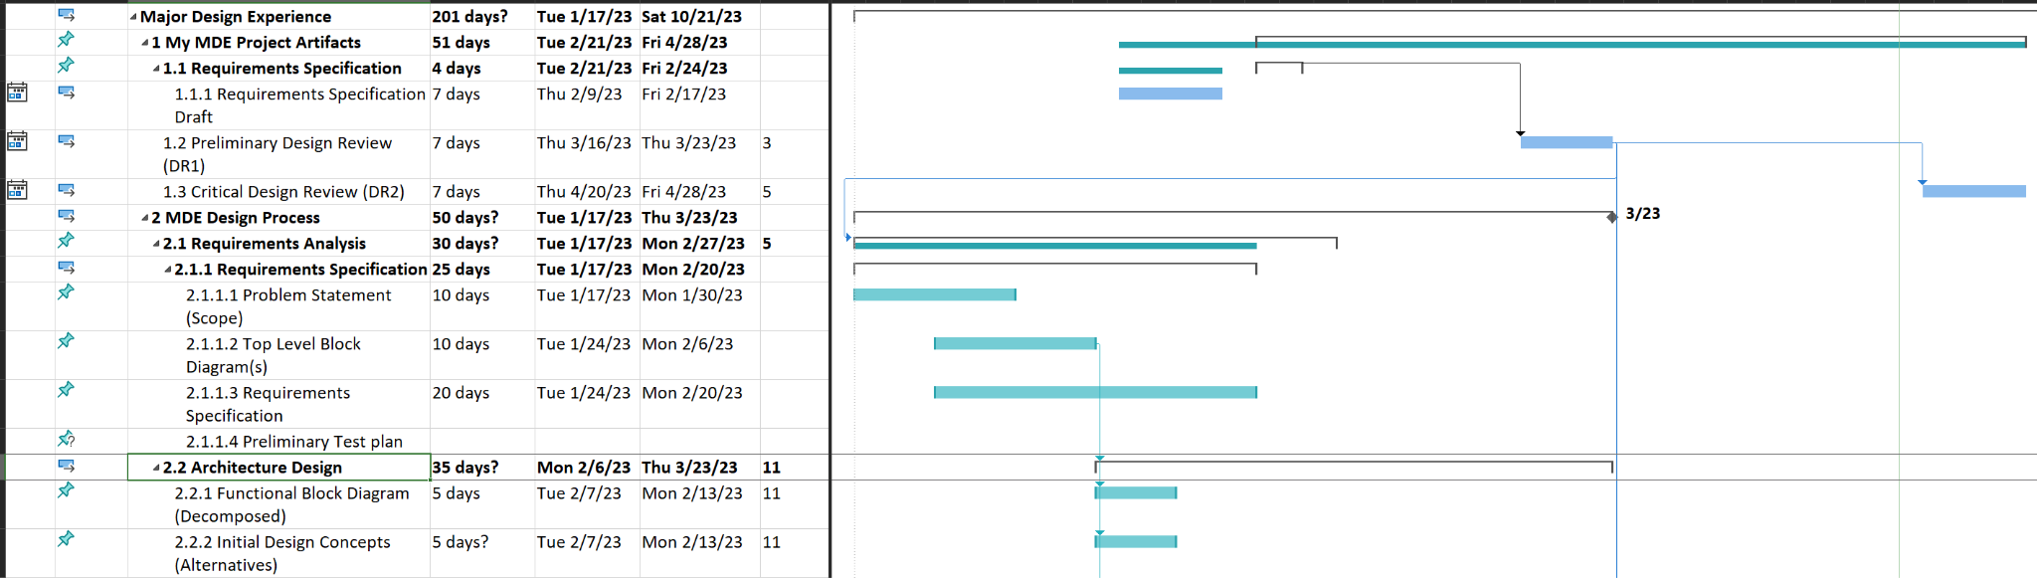
GANTT Schedule

Slide 47
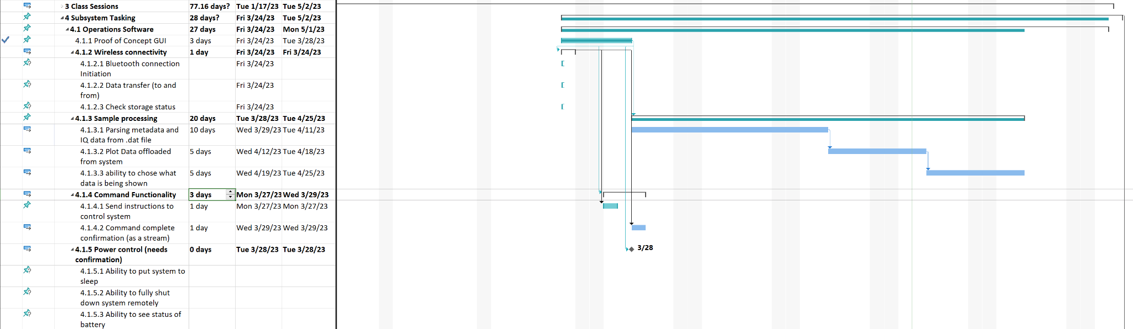
Schedule continued

Slide 48
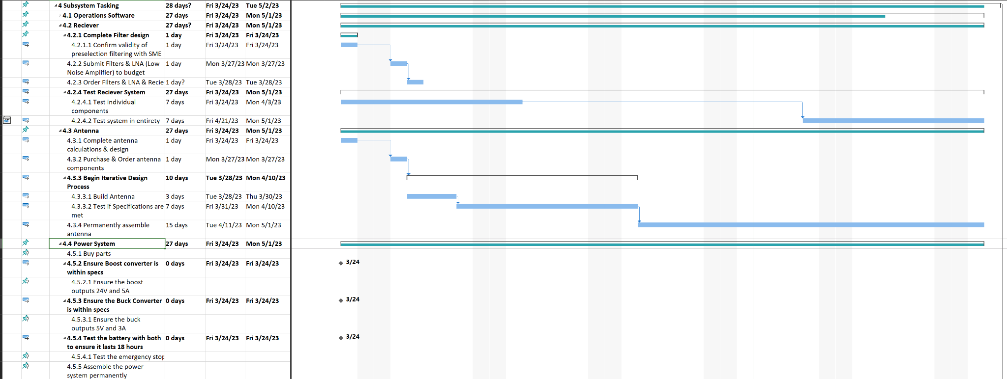
Schedule continued

Slide 49
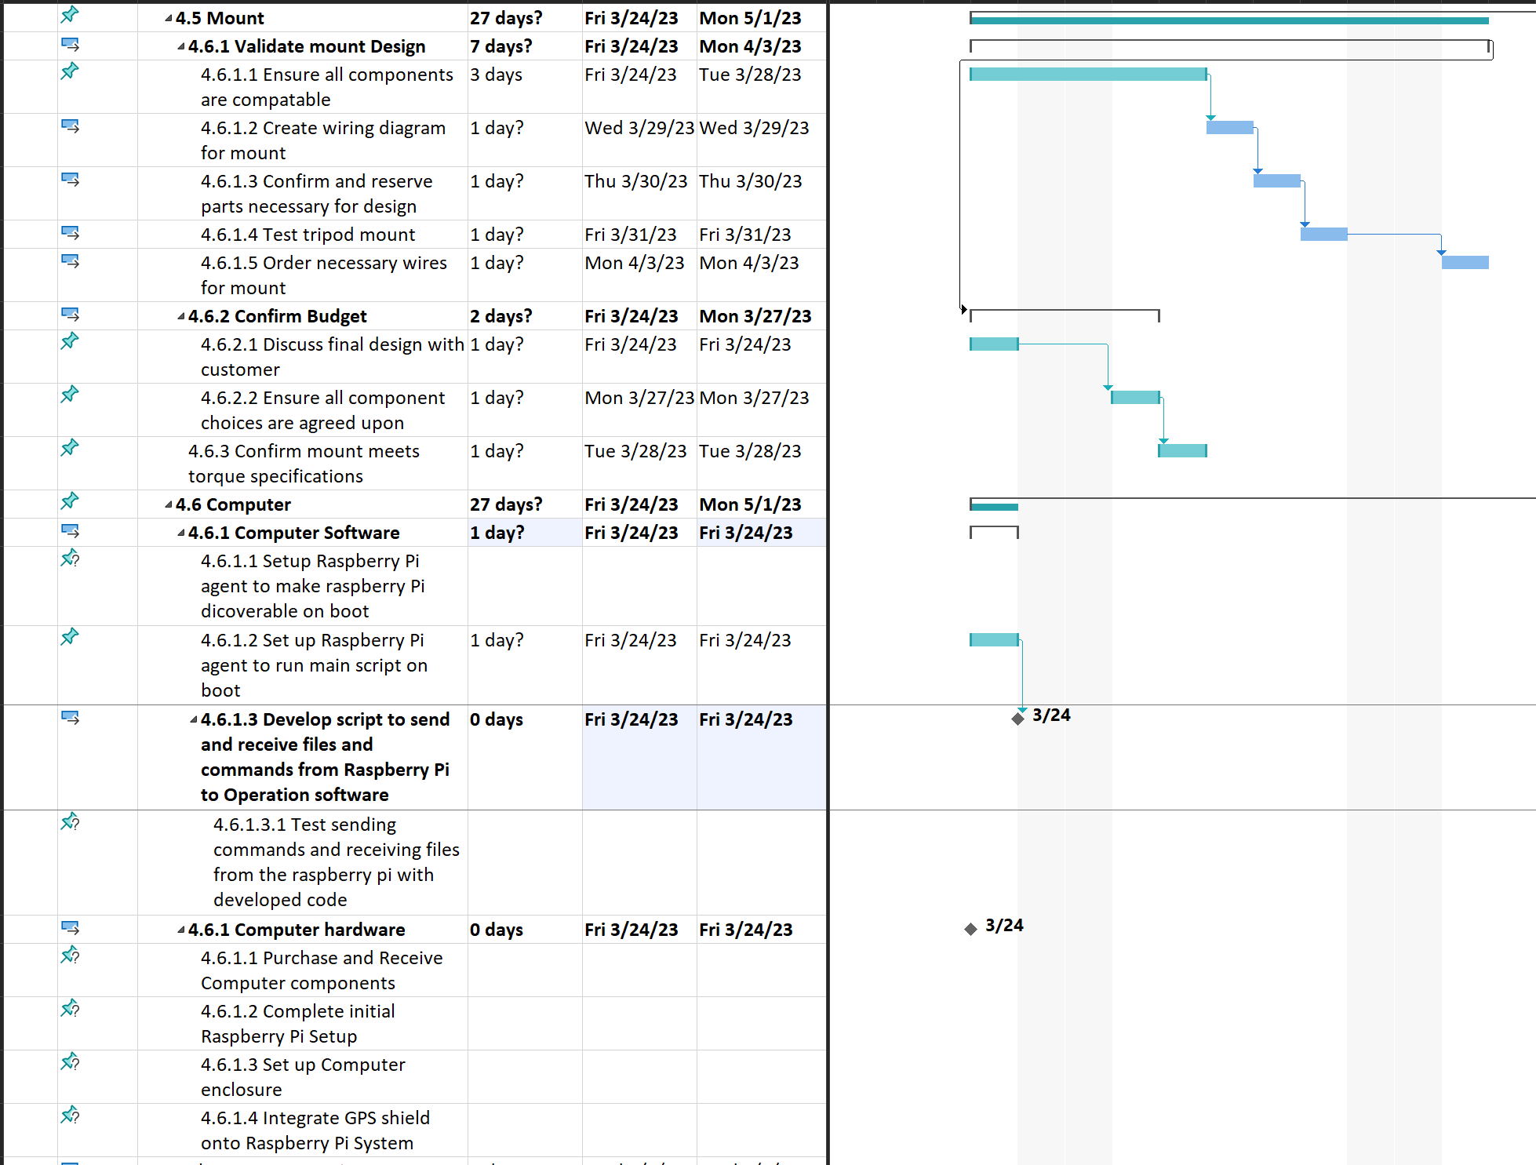

Slide 50
CDR Actions Table
Action # | Requirement | Existing documentation | Plan to fix | Fixed
Make a physical drawing for this system so that we can flesh out the system. | closed
Account for GPS antenna position so that it does not degrade the GPS signal strength | closed
Figure out how to tell which direction is North | closed
Solve issue with device used for execution of software (windows or mac), solve uml sequence on slide 16 | closed

Slide 51
Action # | Open/Closed | Existing documentation | Plan to fix | Fixed
Clear up the mount/computer controller on slide 17 | closed
Make mount / computer sequence diagram ( create deeper level of UML) | closed
Clear up the devices on slide 18 | closed
Is the updating of the mount going to be continuous? Go more in depth with this. All of the commands for the slewing of the mount should be much more defined. Determine the accuracy of the slew rate of the mount. | open
Determine how to keep something from interfering with the rotator movement. Find the IP rating for the mount/controller. | closed

Slide 52
Action # | Open/Closed | Existing documentation | Plan to fix | Fixed
Make a diagram of what the system will look like once it is set up. | closed
Figure out the torque that the tripod can support. (Physical testing) | open
Make a list of tests to test the entire system(acceptance test plan).(Should be the thing we submitted to Mrs. Stover) The flow diagram should reference that assignment. Put in a slide for each subsystem. | open
Make slide 10 more clear(ten minutes of continuous recording, hour of storage). | closed

Slide 53
Action # | Open/Closed | Existing documentation | Plan to fix | Fixed
Reference test plan for test procedure | open
Ask Dr. Ellingson about power control from the computer. | closed
Talk to Mrs. Stover about the schedule.

